Slide 1

LINE FOLLOWING ROBOT
MICROCONTROLLERS
semester Project

Slide 2
Objective
Line follower is a machine that can follow a path. The path can be visible like a black line on a white surface. Sensing a line and manoeuvring the robot to stay on course, while constantly correcting wrong moves using feedback from the sensor forms a simple yet effective system. It can be used in automobile, industrial automations, guidance, etc. Line Follower is one of the most important aspects of robotics. A Line Following Robot is an autonomous robot which is able to follow either a black or white line that is drawn on the surface consisting of a contrasting color. It is designed to move automatically and follow the plotted line.

Slide 3
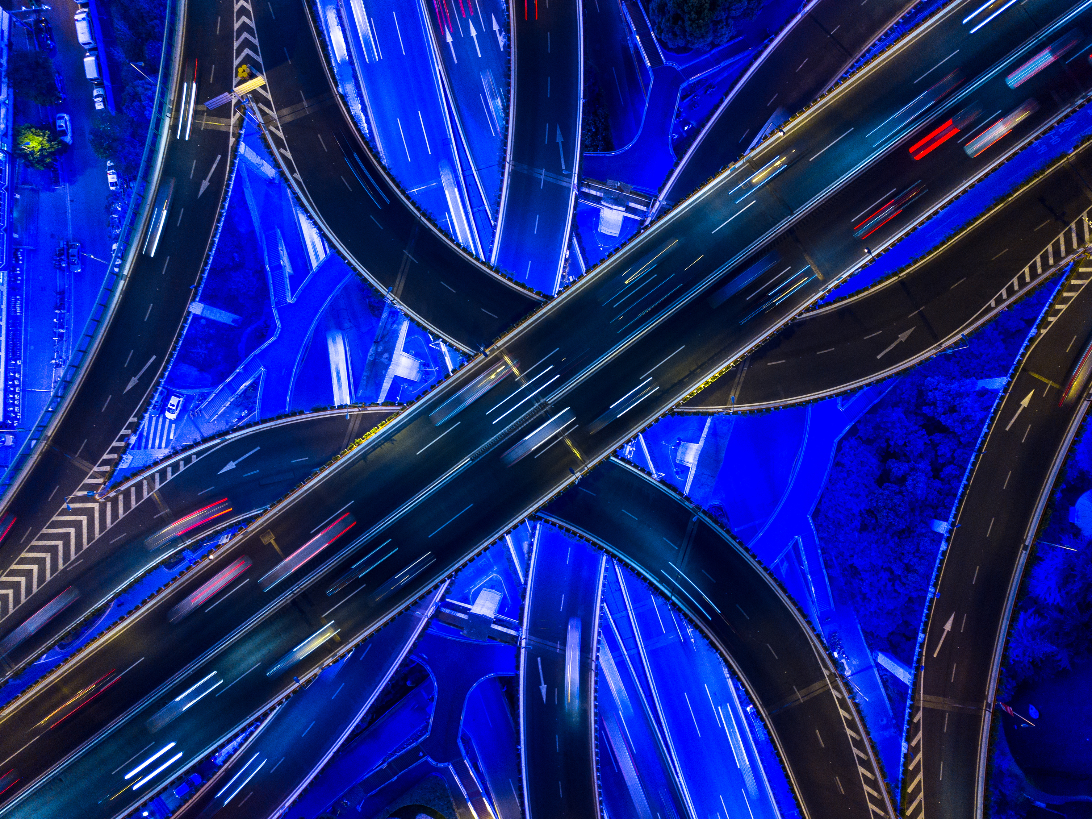
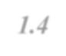

WORK DISTRIBUTION
PHASES | WORK DISTRIBUTION
PHASE I | Simulation on Proteus, Programming
PHASE II | PCB designing and Making
PHASE III | Ordering components
PHASE IV | Implementation on breadboard and then on PCB
PHASE V | Complete Project and final testing
WORK BREAK DOWN STRUCTURE

Slide 4
TEAM MEMBERS ROLES & DETAIL
Team Members | Roles
MADEEHA FAYYAZ | Buying components, writing code, Schematic simulation on Proteus, Assembly of hardware on breadboard, Report Making
WARIS SHAH | Writing code, Technical Work, assembling hardware, Debugging updating code time to time and Report making.
AHSAN MUJAHID | Buying components, Schematic simulation and PCB making, Report making.
FATIMA NAZIR | Schematic simulation and PCB designing on Proteus, writing code, Report making.
HASSAN HAFEEZ | Buying components, Schematic simulation and PCB making, Report making.

Slide 5
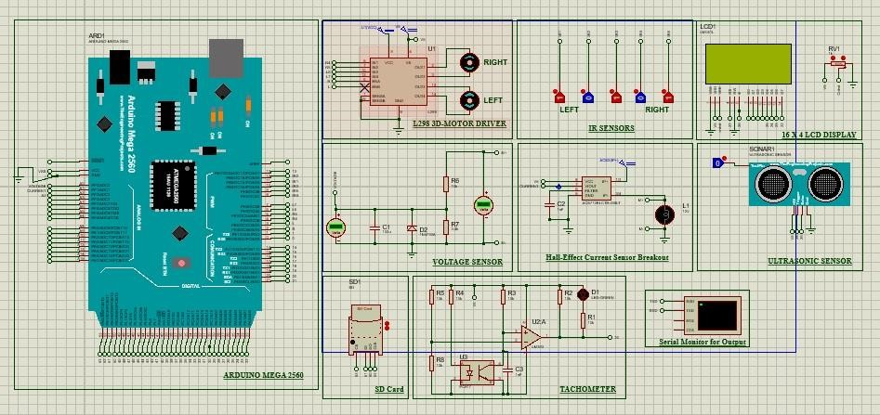
SCHEMATIC CIRCUIT
Figure 7.
1
SCHEMATIC CIRCUIT

Slide 6

Configuration
Pin No. | Symbol |  | Description
1 | VSS |  | Ground
2 | VDD |  | Power supply for logic
3 | V_{O} |  | Contrast Adjustment
4 | RS |  | Data/ Instruction select signal
5 | R/W |  | Read/Write select signal
6 | E |  | Enable signal
7~14 | DB0~DB7 |  | Data bus line
15 | A |  | Power supply for B/L +
16 | K |  | Power supply for B/L -

Slide 7
Description of various parts.
Left Motor | Right Motor | Robot Movement
Straight | Straight | Straight
Stop | Straight | Left
Reverse | Straight | Left
Straight | Stop | Right
Straight | Reverse | Right
Reverse | Reverse | Reverse

Slide 8
ESTIMATED BUDGETS
COMPONENT |  | PRICE
1 chassis (2 tires, 2 motors, bolts, nuts, and base) |  | 1200-1500
Wires (Male to female, male to male, female to female) |  | 400
Soldering Wire |  | 200
Sticker Sheet |  | 120-150
Ultrasonic Sensor |  | 250
Sil headers (male & female) |  | 180-200
Vero board |  | 0
Voltage Sensor |  | 150
Current Sensor |  | 230-250
Double sided tape |  | 100-150
Ferric chloride |  | 250
5 IR sensors |  | 5x180
Adhesives |  | 0
L298N motor driver |  | 350-370
PCB |  | 800
Bread board |  | 140-200
12 battery cells |  | 210
LCD Display |  | 650
SD Card module |  | 200
Servo motor |  | 280
Ultrasonic sensor Holder |  | 70-100
Nail Polish remover (Acetone) |  | 80
 | Total = 8,000-9,000

Slide 9
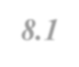

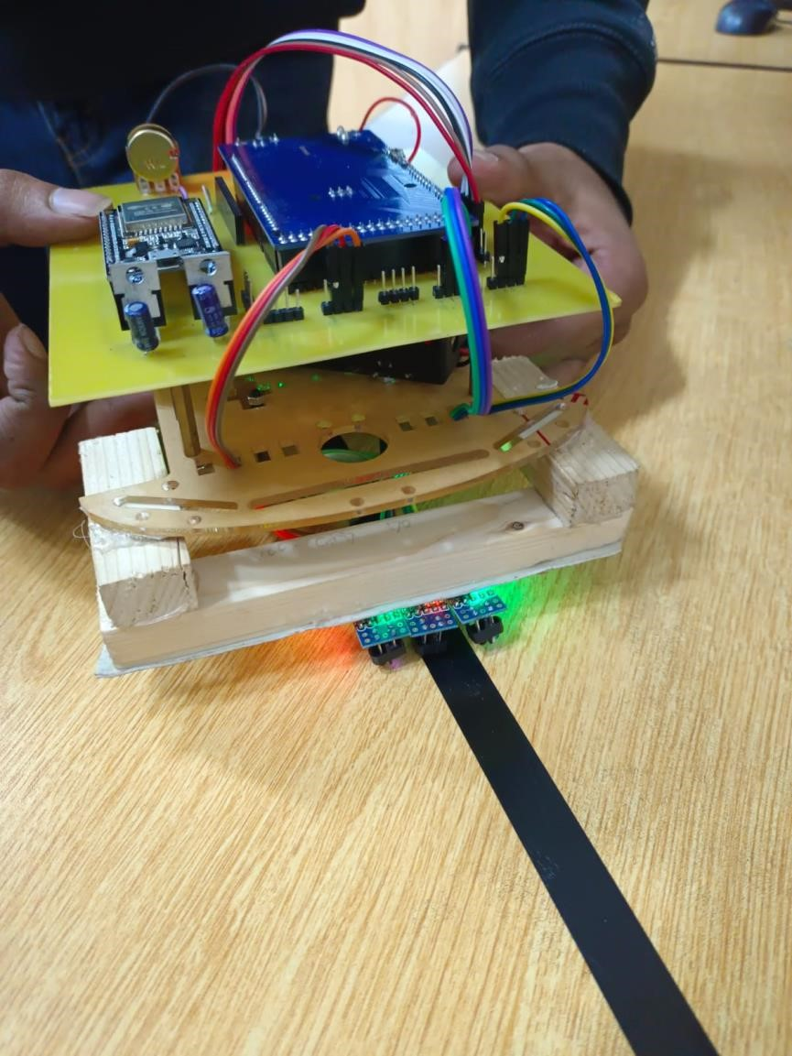
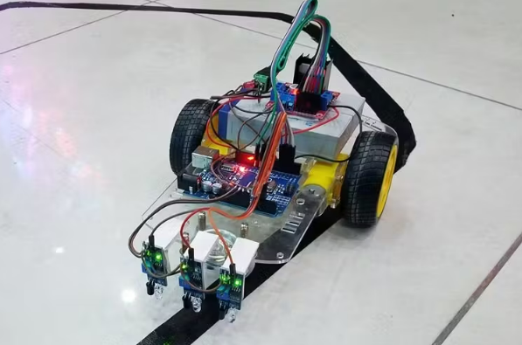
Final Testing
8.1
TESTING
Figure 8
.1
TESTING

Slide 10

CONCLUSION​
In this project, we have designed a line following robot. This robot does not need any remote controller or any controller like Bluetooth, Wi-Fi, GSM, driver etc, it will run automatically with following a line. This robot is very low cost but very effective for various purposes.Our project can be used in various sectors like in medicine delivering in hospitals, delivering products in any places, spying, and surveillance and so on. In future we can add several sensors, cameras etc to get more features.

Slide 11
THANK YOU
M Ahsan​
+92 3170612828
211281@students.au.edu.pk

